Slide 1
©2023 Unilever Canada Inc.

Slide 2
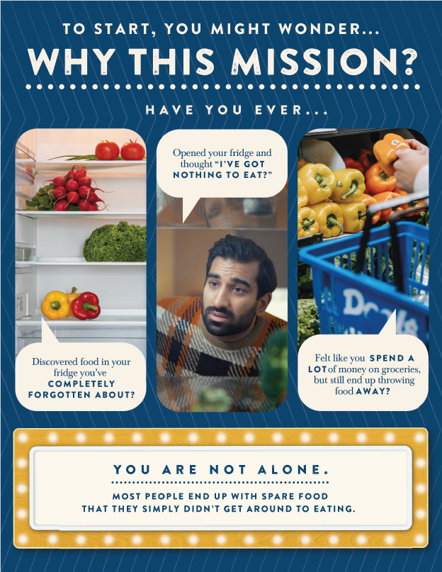

Slide 3
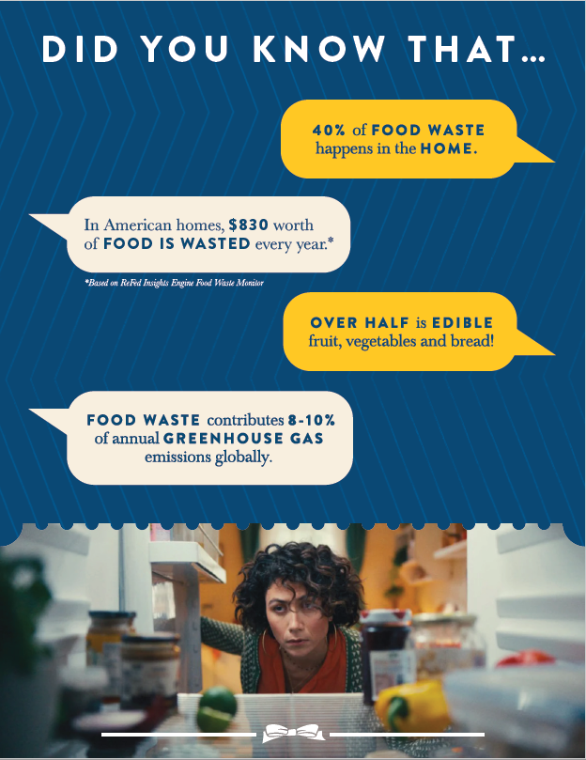
61%
UNEP Food Waste Index 2021
In Canadian homes, $1352 worth
*Love Food Hate Waste Canada, Making Every Bite Count, 2021 Inflation adjusted
UN Environment Program Food Waste Index Report, 2021

Slide 4
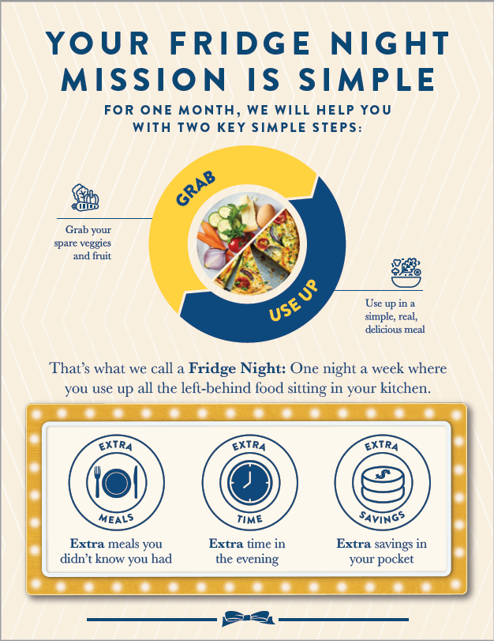
WEEK,

Slide 6
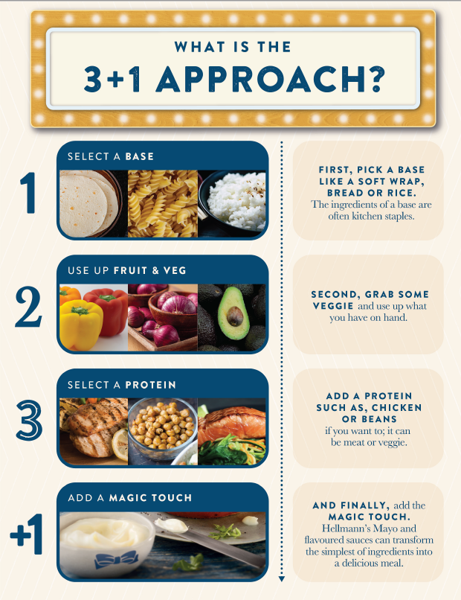
Things like

Slide 7
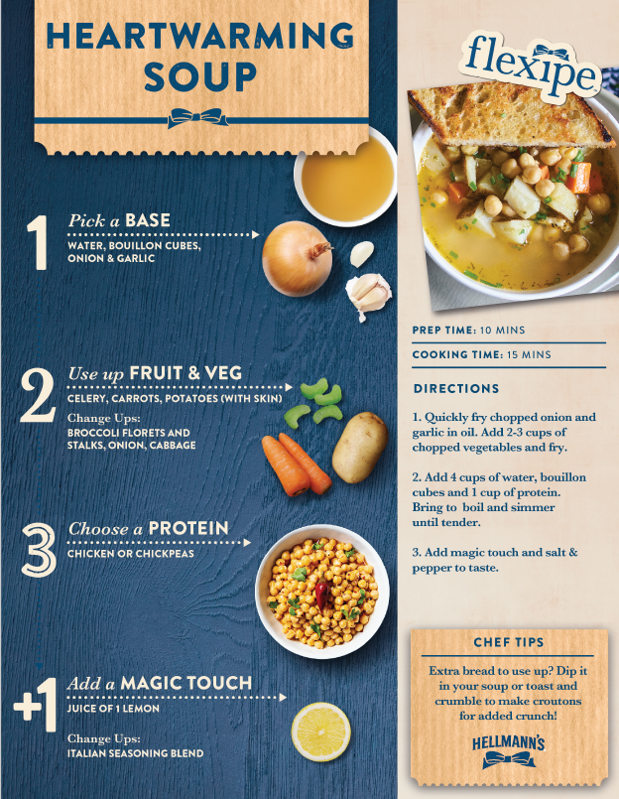

Slide 8
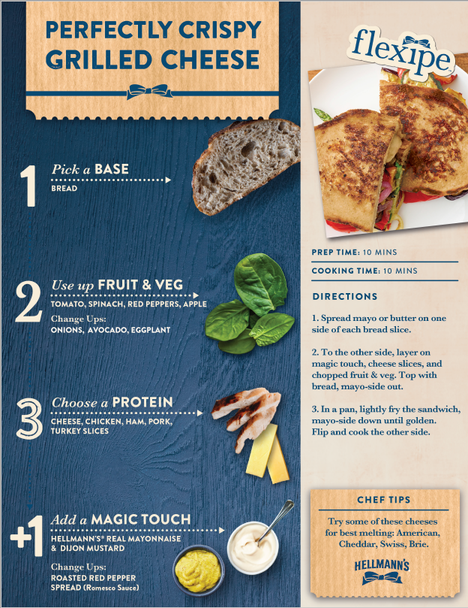

Slide 9
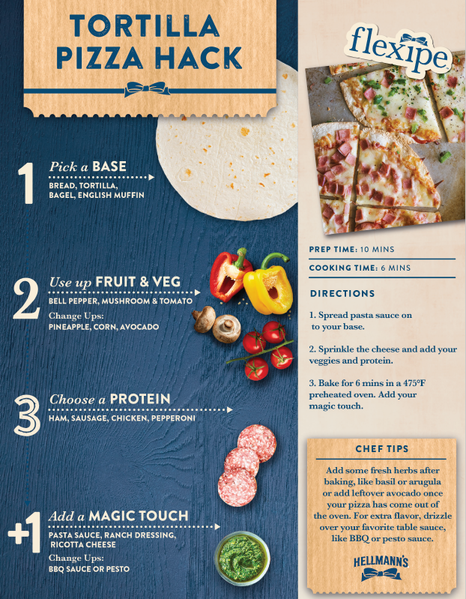

Slide 10
SCAVENGER HUNT
HOW IT WORKS:
Hidden around the room are some of the most commonly wasted ingredients. Find as many ingredients as you can and use your creativity to come up with your own unique Flexipe!
Remember the 3+1 Approach:
Whoever comes up with the best new Flexipe will win an AWESOME surprise prize!

Slide 11
THE JAR CHALLENGE
HOW IT WORKS:
Let’s see if you can take what you’ve learned and apply it at home!
For the next week, take any food scraps or leftovers that you would have thrown in the garbage and place them in an empty jar or container. Try and use the concepts you’ve learned, like cooking Flexipes or picking one Use-Up day, to reduce your food waste and keep your jars as empty as possible!
Whoever has the least full jar by the end of the week will win an AWESOME surprise prize!

Slide 12
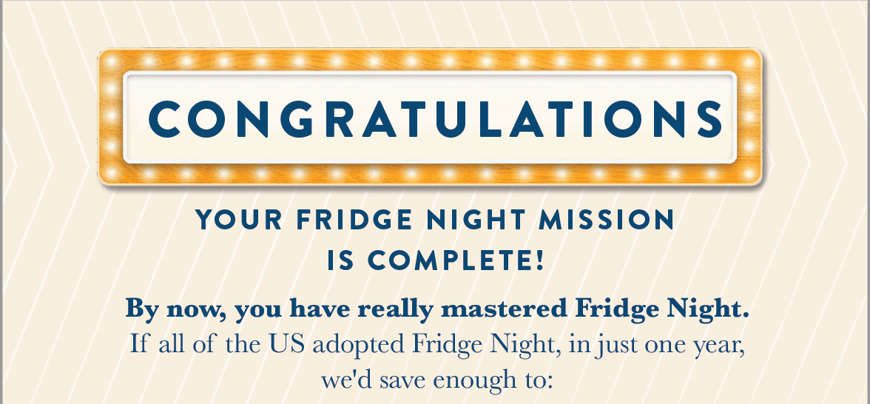
Keep up the great work and let’s continue to look for easy ways to reduce food waste!

